Slide 1
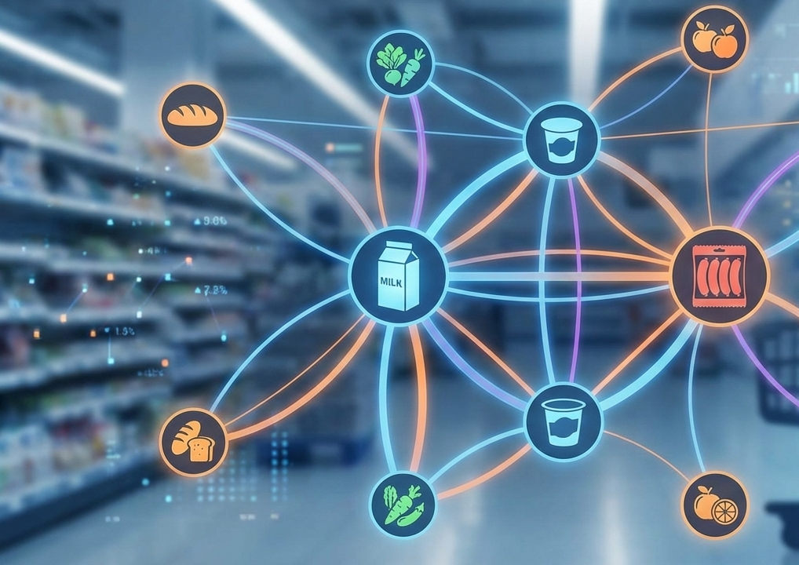
Market
Basket
Analysis
Grocery Data Using the Apriori Algorithm
Keith Fernandes
https://www.linkedin.com/in/keithfernandes12/
Notes:
Author: Mark Nold
Website: https://marknold.substack.com
This template is intended to help future business leaders and consultants learn how to communicate better. It is available at marknold.substack.com
This template is released under Creative Commons By 4.0 Deed, which means
* You are free to Share and Adapt, but;
* You must give appropriate credit to the author and website.
eg: "Using Mark Nold’s template found at https://marknold.substack.com"
For further details on the Creative Commons By 4.0 Deed, please see https://creativecommons.org/licenses/by/4.0/

Slide 2
Whole Milk is the Anchor Product
The Strongest Purchasing Associations in 14,963 Grocery Baskets
MARKET BASKET ANALYSIS | EXECUTIVE SUMMARY
Analysis of 38,765 transaction records across 167 products reveals actionable product clusters for retail optimization
Situation
A grocery retailer has 2 years of transactional data (Jan 2014 – Dec 2015) covering 38,765 purchase records from 3,898 customers across 167 unique products.
The retailer wants to understand which products customers buy together to inform store layout, promotions, and cross-selling.
Complication
With 167 products the number of possible item combinations is enormous — manual analysis is impossible.
Without data-driven insights, shelf placement and promotional strategies rely on intuition rather than evidence.
Questions
Which products are most frequently purchased together?
What are the strongest product associations (measured by lift)?
How can these patterns translate into concrete retail strategies?
Answer
The Apriori algorithm identified 811 frequent itemsets and 1,376 association rules.
The strongest rule — {whole milk, yogurt} → {sausage} at lift 2.18× — suggests customers buying milk and yogurt are over twice as likely to also buy sausage.
Four actionable strategies emerge: shelf co-placement, promotional bundling, targeted marketing, and store layout optimization.
Notes:
Author: Mark Nold
Website: https://marknold.substack.com
This template is intended to help future business leaders and consultants learn how to communicate better. It is available at marknold.substack.com
This template is released under Creative Commons By 4.0 Deed, which means
* You are free to Share and Adapt, but;
* You must give appropriate credit to the author and website.
eg: "Using Mark Nold’s template found at https://marknold.substack.com"
For further details on the Creative Commons By 4.0 Deed, please see https://creativecommons.org/licenses/by/4.0/

Slide 3
Association Rule Mining
Discovers Co-purchased Products from Transaction Data
METHODOLOGY | WHAT IS MARKET BASKET ANALYSIS?
Three key metrics: Support, Confidence, and Lift; measure the strength and reliability of product associations
SUPPORT
LIFT
Measures how popular an itemset is
Proportion of transactions containing the itemset
Example: Whole milk appears in 15.8% of all transactions
Measures association strength vs random chance
Lift > 1 = positive association
Example: {whole milk, yogurt} → sausage has lift 2.18×
CONFIDENCE
APRIORI ALGORITHM
Measures how likely item B is bought given item A
Conditional probability P(B|A)
Example: {sausage, yogurt} → whole milk has 25.6% confidence
Iteratively finds frequent itemsets level by level
Prunes infrequent candidates at each step (Apriori property)
Parameters: min_support = 0.1%, max itemset length = 5
Notes:
Author: Mark Nold
Website: https://marknold.substack.com
This template is intended to help future business leaders and consultants learn how to communicate better. It is available at marknold.substack.com
This template is released under Creative Commons By 4.0 Deed, which means
* You are free to Share and Adapt, but;
* You must give appropriate credit to the author and website.
eg: "Using Mark Nold’s template found at https://marknold.substack.com"
For further details on the Creative Commons By 4.0 Deed, please see https://creativecommons.org/licenses/by/4.0/

Slide 4
Two Years Of Grocery Transactions
3,898 Customers Across 167 Products
DATA | DATASET OVERVIEW
Most baskets are small (median = 2 items), making each co-purchase signal highly meaningful for association analysis
38,765
14,963
Purchase Records
Transaction Baskets
Total individual item purchase records spanning
Jan 2014 to Dec 2015
Unique shopping baskets formed by grouping items
by customer and date
167
3,898
Unique Products
Customers
Distinct grocery items ranging from whole milk to
kitchen utensils.
Unique customer IDs tracked across the 2-year period.
Notes:
Author: Mark Nold
Website: https://marknold.substack.com
This template is intended to help future business leaders and consultants learn how to communicate better. It is available at marknold.substack.com
This template is released under Creative Commons By 4.0 Deed, which means
* You are free to Share and Adapt, but;
* You must give appropriate credit to the author and website.
eg: "Using Mark Nold’s template found at https://marknold.substack.com"
For further details on the Creative Commons By 4.0 Deed, please see https://creativecommons.org/licenses/by/4.0/

Slide 5
Whole Milk Dominates With 2,363 Purchases
83% More than the 3rd-Ranked Item
DATA | ITEM FREQUENCY ANALYSIS
The Top 5 Items: Whole Milk, Other Vegetables, Rolls/Buns, Soda, Yogurt; account for a disproportionate share of all transactions
Notes:
Author: Mark Nold
Website: https://marknold.substack.com
This template is intended to help future business leaders and consultants learn how to communicate better. It is available at marknold.substack.com
This template is released under Creative Commons By 4.0 Deed, which means
* You are free to Share and Adapt, but;
* You must give appropriate credit to the author and website.
eg: "Using Mark Nold’s template found at https://marknold.substack.com"
For further details on the Creative Commons By 4.0 Deed, please see https://creativecommons.org/licenses/by/4.0/

Slide 6
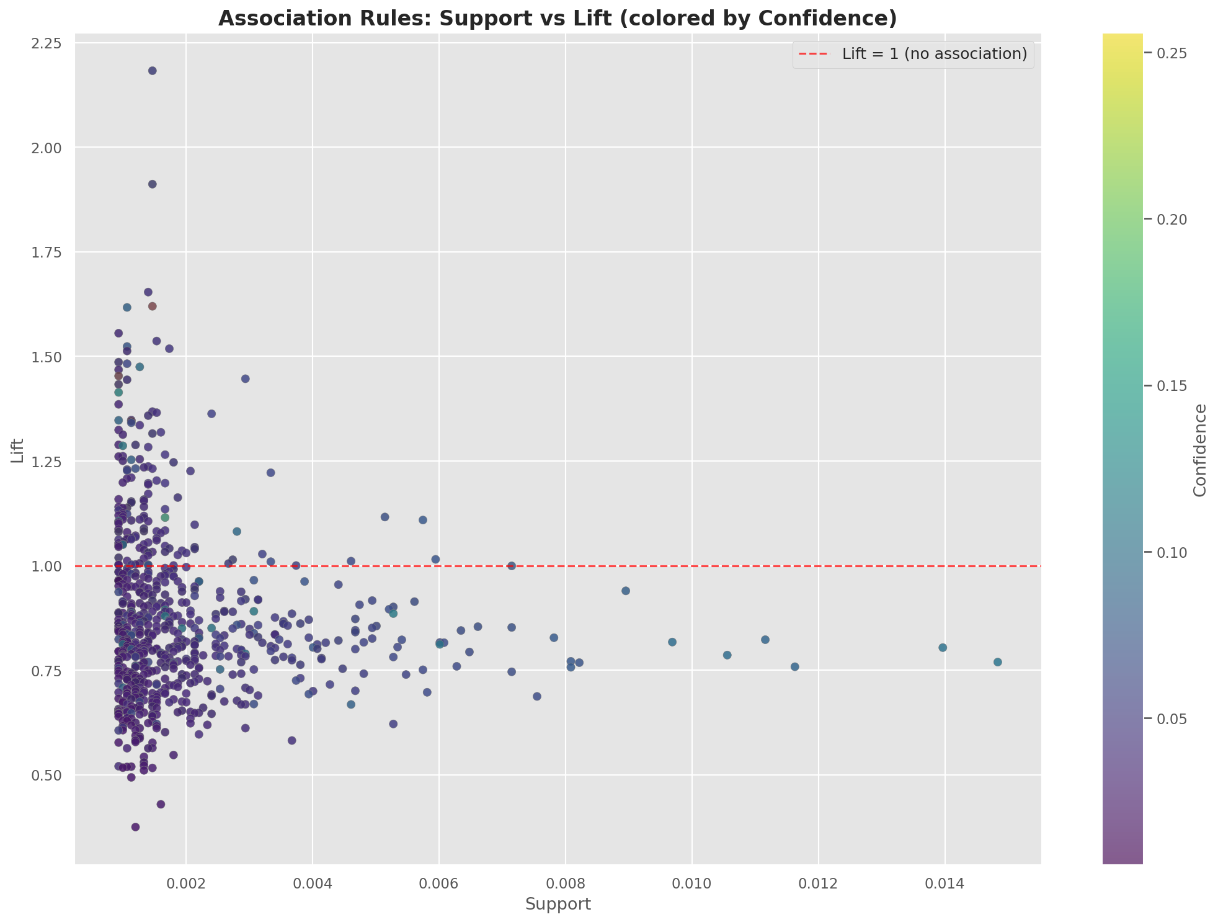
811 Frequent Itemsets and
1,376 Association Rules Discovered At 0.1% Support Threshold
METHODOLOGY | WHAT IS MARKET BASKET ANALYSIS?
The algorithm found 149 frequent single items, 649 item pairs, and 13 three-item combinations, with rules up to lift 2.18x
Association Rules: Support v/s Lift (colored by Confidence)
Minimum Support: 0.1%
(Appears In ≥15 Of 14,963 Transactions)
Max Itemset Length: 5 Items
649 Frequent Item Pairs Discovered
13 Three-item Combinations Found
Rules Range From Lift 0.5x To 2.18x
High-lift Rules Cluster At Low Support
(Niche But Strong Associations)
Notes:
Author: Mark Nold
Website: https://marknold.substack.com
This template is intended to help future business leaders and consultants learn how to communicate better. It is available at marknold.substack.com
This template is released under Creative Commons By 4.0 Deed, which means
* You are free to Share and Adapt, but;
* You must give appropriate credit to the author and website.
eg: "Using Mark Nold’s template found at https://marknold.substack.com"
For further details on the Creative Commons By 4.0 Deed, please see https://creativecommons.org/licenses/by/4.0/

Slide 7
Customers Buying Whole Milk and Yogurt Are 2.18x more likely to also Buy Sausage
RESULTS | TOP ASSOCIATION RULES BY LIFT
The seven strongest rules all involve core staple products, confirming natural "meal basket" purchasing clusters
ANTECEDENT | CONSEQUENT | SUPPORT | CONFIDENCE | LIFT
{whole milk, yogurt} | {sausage} | 0.15% | 13.2% | 2.18
{sausage, whole milk} | {yogurt} | 0.15% | 16.4% | 1.91
{specialty chocolate} | {citrus fruit} | 0.14% | 8.8% | 1.65
{sausage, yogurt} | {whole milk} | 0.15% | 25.6% | 1.62
{tropical fruit} | {flour} | 0.11% | 1.6% | 1.62
{soda, whole milk} | {pastry} | 0.09% | 8.0% | 1.56
{beverages} | {sausage} | 0.15% | 9.3% | 1.54
Notes:
Author: Mark Nold
Website: https://marknold.substack.com
This template is intended to help future business leaders and consultants learn how to communicate better. It is available at marknold.substack.com
This template is released under Creative Commons By 4.0 Deed, which means
* You are free to Share and Adapt, but;
* You must give appropriate credit to the author and website.
eg: "Using Mark Nold’s template found at https://marknold.substack.com"
For further details on the Creative Commons By 4.0 Deed, please see https://creativecommons.org/licenses/by/4.0/

Slide 8
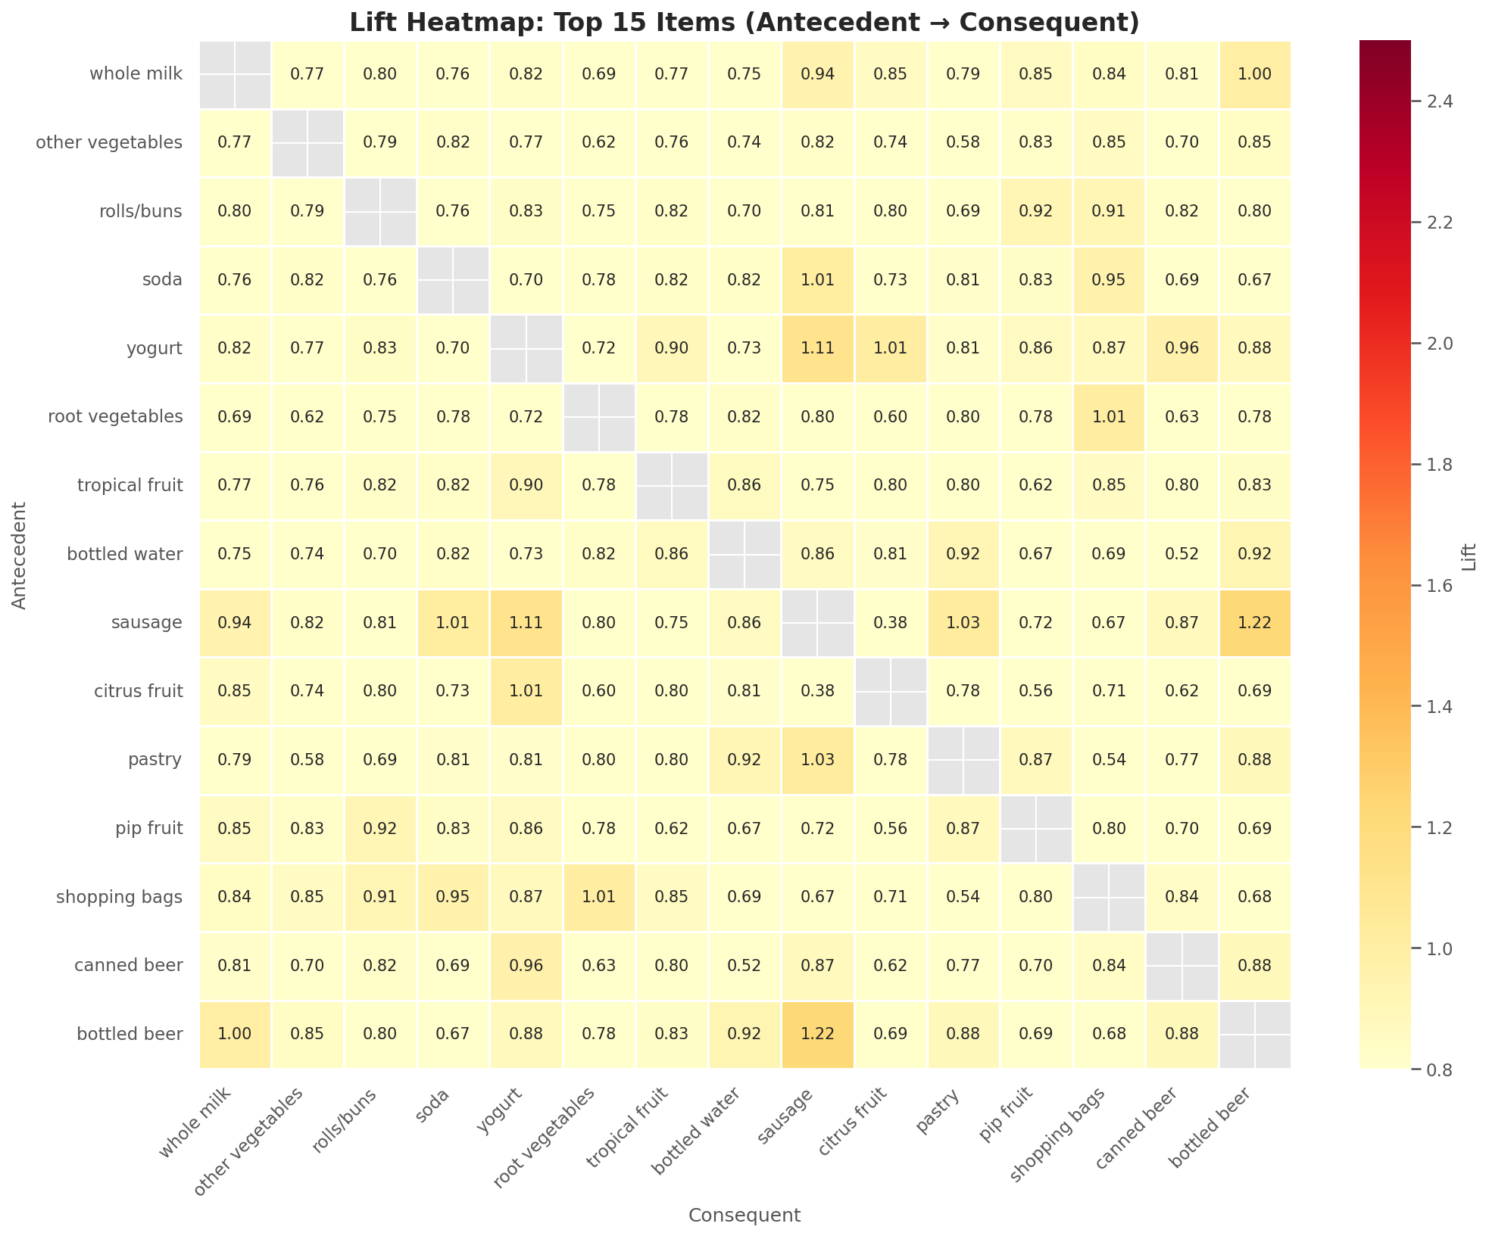
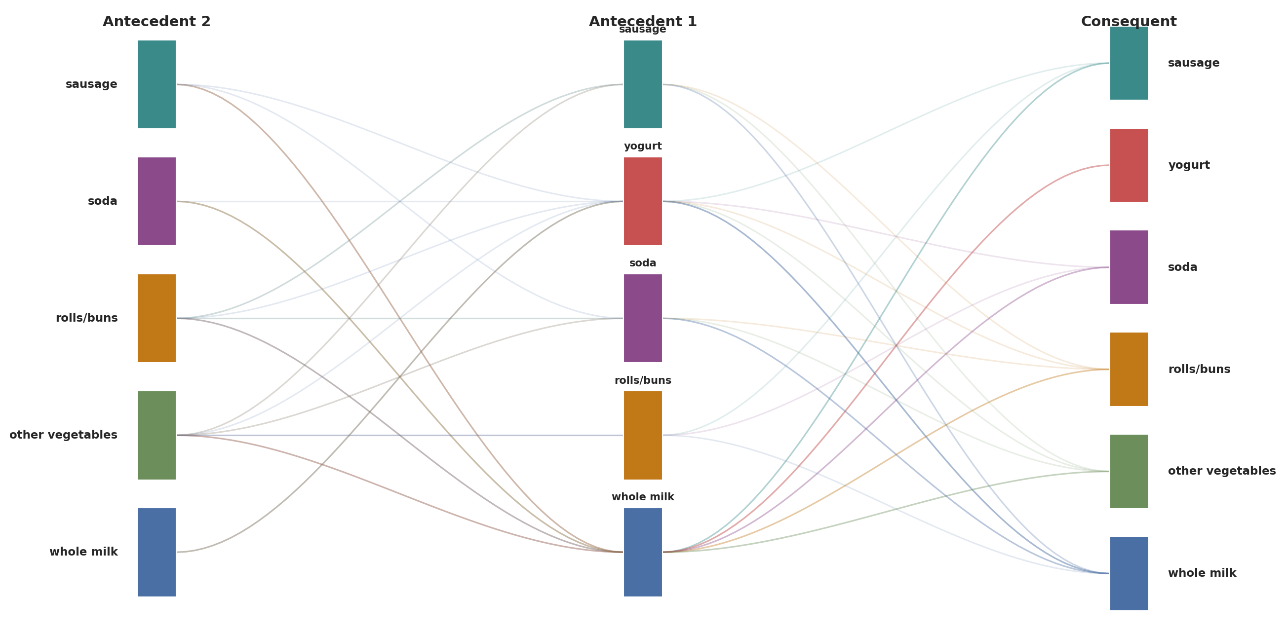
Whole Milk Sits at the Center of the Strongest Association
Flows Across All Product Categories
RESULTS | VISUALIZING PRODUCT ASSOCIATIONS
The heatmap reveals pairwise lift values while the Sankey diagram shows multi-item rule flows between antecedents and consequents
Lift Heatmap: Top 15 Items
(Antecedent → Consequent)
Association Rules Flow:
Antecedent 2 → Antecedent 1 → Consequent
Notes:
Author: Mark Nold
Website: https://marknold.substack.com
This template is intended to help future business leaders and consultants learn how to communicate better. It is available at marknold.substack.com
This template is released under Creative Commons By 4.0 Deed, which means
* You are free to Share and Adapt, but;
* You must give appropriate credit to the author and website.
eg: "Using Mark Nold’s template found at https://marknold.substack.com"
For further details on the Creative Commons By 4.0 Deed, please see https://creativecommons.org/licenses/by/4.0/

Slide 9
Four Data-driven Strategies
To Increase Basket Size And Optimize Store Performance
RECOMMENDATIONS | BUSINESS APPLICATIONS
Each recommendation is directly supported by association rules with lift >1.5x, indicating statistically meaningful co-purchase patterns
SHELF PLACEMENT
PROMOTIONAL BUNDLING
Place sausage near yogurt and whole milk (lift 2.18×)
Co-locate rolls/buns with sausage (lift 1.47×)
Position complementary items within line-of-sight
Create combo deals: whole milk + yogurt + sausage
Bundle rolls/buns + sausage for "meal deal" pricing
Discount one item in high-lift pairs to drive basket uplift
TARGETED MARKETING
  STORE LAYOUT
Recommend associated items at checkout
Send targeted offers: yogurt buyers get sausage coupons
Use lift-ranked rules to prioritize recommendation engine
Use the Sankey flow to plan category adjacency
Anchor whole milk centrally (15.8% of all baskets)
Create "meal solution" zones grouping top clusters together
Notes:
Author: Mark Nold
Website: https://marknold.substack.com
This template is intended to help future business leaders and consultants learn how to communicate better. It is available at marknold.substack.com
This template is released under Creative Commons By 4.0 Deed, which means
* You are free to Share and Adapt, but;
* You must give appropriate credit to the author and website.
eg: "Using Mark Nold’s template found at https://marknold.substack.com"
For further details on the Creative Commons By 4.0 Deed, please see https://creativecommons.org/licenses/by/4.0/

Slide 10

Thank you.
https://github.com/keithfernandes12/Market-Basket-Analysis
Python • pandas • NumPy • mlxtend • matplotlib • seaborn • PyARMViz
Notes:
Author: Mark Nold
Website: https://marknold.substack.com
This template is intended to help future business leaders and consultants learn how to communicate better. It is available at marknold.substack.com
This template is released under Creative Commons By 4.0 Deed, which means
* You are free to Share and Adapt, but;
* You must give appropriate credit to the author and website.
eg: "Using Mark Nold’s template found at https://marknold.substack.com"
For further details on the Creative Commons By 4.0 Deed, please see https://creativecommons.org/licenses/by/4.0/

